Slide 1

Burnaby School District New Staff Health & Safety Orientation

Slide 2

Burnaby Schools Safety Responsibilities
District Joint Health & Safety Committee
Worksafe BC
District Health and Safety Staff
You
School/site Joint Health & Safety Committee
Your Supervisor, Manager and/or Principal
Each of the following people or authorities at Burnaby Schools have an important role in maintaining a safe and healthy workplace
Safe and Healthy Workplace
You are a fresh set of eyes and are invaluable at your worksite

Slide 3


Employer Responsibilities
Provide a safe, healthy and secure work environment
Where required, have First Aid Attendants
Ensure compliance with WorkSafe BC Occupational Health and Safety Regulations
Ensure employees are made aware of health and safety hazards
Provide applicable information and training
Correct and report unsafe practice
Work with the Joint Occupational Health and Safety Committees (JOHSC) and District Occupational Health and Safety Committees (DOHS) to address health & safety matters

Slide 4

Employee Responsibilities
Refuse and report work that is unsafe
Be prepared to work in a safe manner at all times
Follow safety measures and wear appropriate protective equipment when required

Slide 5

Employee Rights
All employees in B.C. have FOUR basic rights:
1. The right to participate
Occupational Health and Safety Committees
2. The right to know about:
Reporting injury or incidents
Hazards in the workplace
3. The right to refuse unsafe work
Refusal of work that is hazardous
4. The right to no discrimination
Freedom from retribution for refusing unsafe work or asking for help

Slide 6

Joint Occupational Health and Safety Committees
If a workplace has more than 20 employees, a safety committee is required
The committee must be comprised of a minimum of 4 members (i.e Managers, Administrators, BTA, CUPE 379)
The Committee:
Conducts site inspections
Identifies hazards
Investigates accidents or incidents
Communicates to Staff
Makes recommendations to management

Slide 7

Reporting a Safety Concern
Report a safety concern to your Supervisor verbally or in writing by completing the Health & Safety Concern / Hazardous Condition form that can be found in the Health and Safety Portal
OR
Report a safety concern to your site JOHSC Committee or Health and Safety Representative

Slide 8

Reporting an Injury or Incident
Report the injury or incident to your Supervisor as soon as possible.
Seek first aid from on site attendant or see a doctor if injured.
Call WorkSafeBC Teleclaim 1-888-WORKERS and report to the Joint Health & Safety Committee
Let your Supervisor know if a WorksafeBC claim has been filed so that the appropriate forms can be completed.

Slide 9

Injury / Illness Forms
First Aid Report: Completed by your local First Aid Attendants
Form A: Workers Report of Injury to Employer
Submitted by the employee to Supervisor/Manager
Form B: Report of Injury or Occupational Disease to WorkSafe BC
Submitted by the employer to WorkSafe BC when there is time loss.
Incident Investigation Report
Completed by the employer and you may be requested to participate and provide feedback
Preliminary Investigation within 48 hours
Full Investigation within 30 days
All forms can be accessed on the District Health and Safety Web Portal.

Slide 10
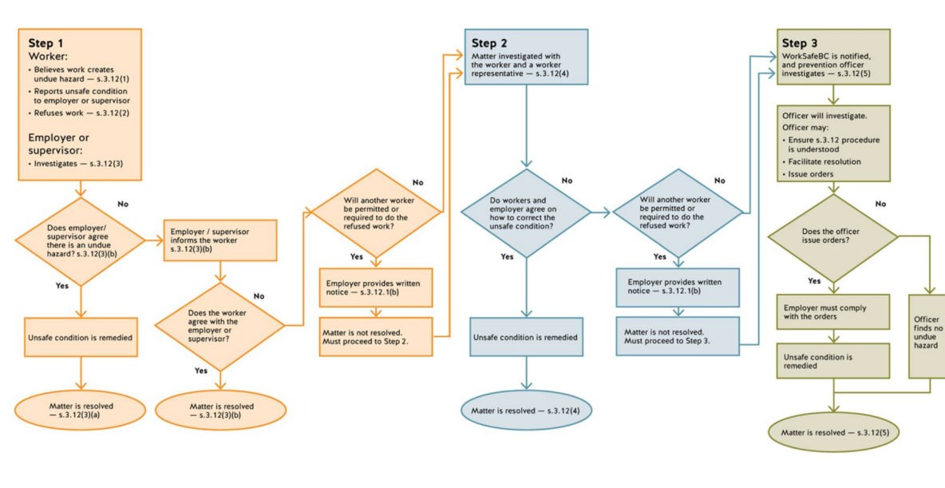

Refusal of Unsafe Work Flowchart
*You must immediately notify your supervisor or employer in person, who will then investigate, take the appropriate steps to determine if the work is unsafe and remedy the situation.

Slide 11
Violence Prevention and Safety Plan
Violence: “The attempted or actual exercise by a person, other than a worker, of any physical force so as to cause injury to worker and includes any threatening statement or behavior which gives a worker reasonable cause to believe that he or she is at risk of injury.” - Definition as per WorkSafeBC OHSR 4.27:
Recognize – know a student’s baseline behavior and take note of changes
Report violent incidents (victim or witness) – employees to seek first aid if required and report to your Supervisor/Administrator
Assess and Investigate – a risk assessment and Incident investigation may be initiated by the Supervisor
Plan and Implement – a safety procedure/plan may be developed to keep the worker safe (prevention, correction, mitigation)
Communicate and Share – all possible affected employee(s) must know the risk and the plan
Monitor and Adjust – review the plan and ensure that if there are changes, these are communicated

Slide 12

WHMIS
The Workplace Hazardous Materials Information System (WHMIS) is used to communicate chemical hazard information to all employees.
There are three parts of the system:
Labels
Safety data sheets (SDS)
Worker education (training)
NOTE: Some products are not controlled by WHMIS 2015, such as some household cleaners, cosmetics, drugs, and pesticides. If they are hazardous, they will have consumer products labels, or other labels that will outline hazards

Slide 13
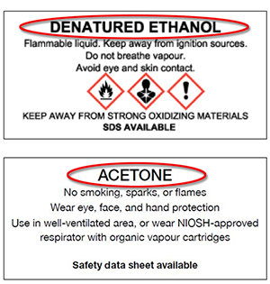
WHMIS Label Details
Product Identifier
All WHMIS labels must identify the product that it is for

Slide 14
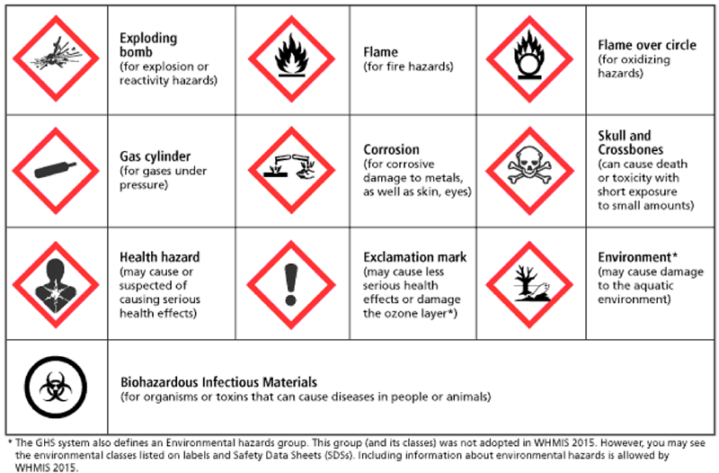
WHMIS Label Details
Hazard Symbols and Statements
WHMIS has a series of symbols called Pictograms designed to communicate potential dangers certain products might have

Slide 15
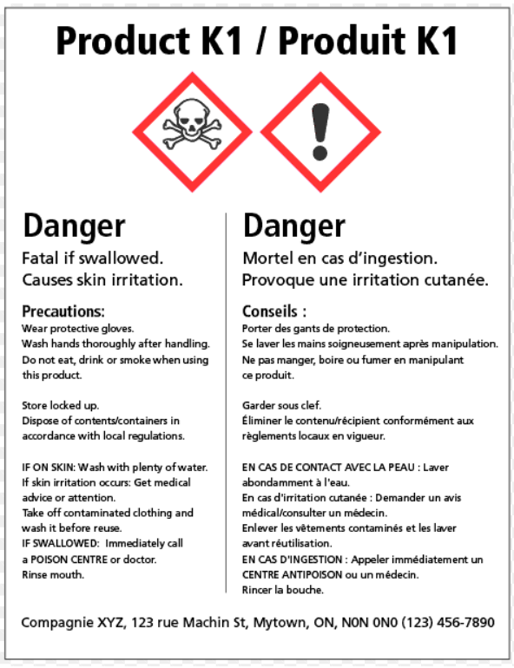
WHMIS Label Details
Signal Words
Signal words such as "Danger" or "Warning" are used to emphasize hazards and indicate severity of the hazard.
Supplier Information
This area of the label provides contact information of the company that made, packaged, sold, or imported the product.

Slide 16
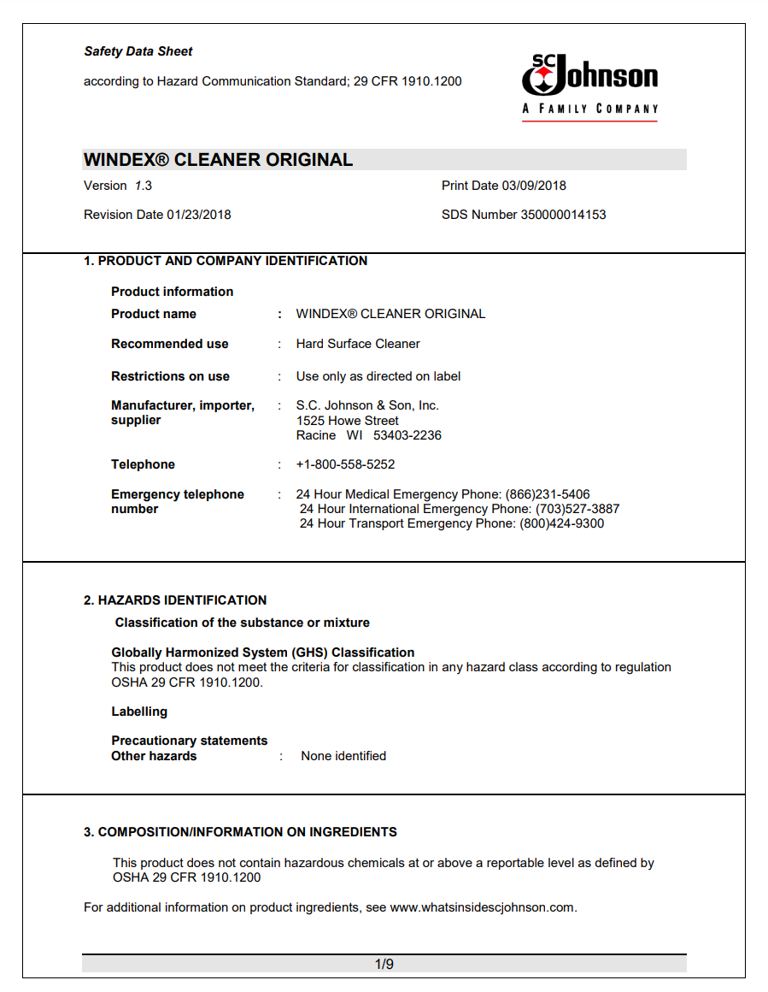
WHMIS Safety Data Sheet (SDS)
A safety data sheet (SDS) provides you with important information about the chemical you are using including hazards and safety precautions.

Slide 17
SDS Database
The Burnaby School District SDS database can be found on the Health and Safety Staff portal where up to date SDS sheets and labels can be found. For more information or, if you can not locate the SDS, please contact healthandsafety@burnabyschools.ca

Slide 18
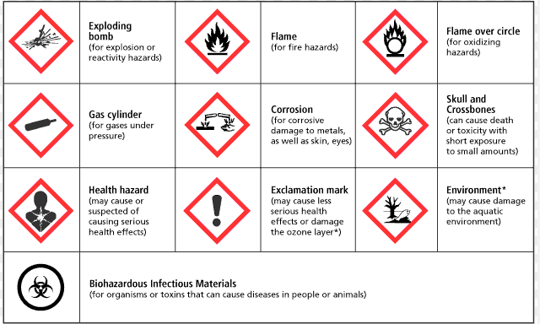
WHMIS Training
The Burnaby School District WHMIS self paced training can be found on the Health and Safety Portal. For assistance, please contact healthandsafety@burnabyschools.ca

Slide 19

Finding information
You can find Health and Safety guidance and information on the Burnaby School District Staff Portal.
Information Includes:
Asbestos Inventories
JOHSC Database for meeting minutes
Health and Safety policies and procedures
Emergency Response Guidance
Drills and inspections
Health and Safety forms such as:
Reporting a hazard
Refusal of unsafe work
6A (worker report of injury or occupational disease to WorksafeBC)

Slide 20



Welcome!
Remember:
You are an important part of the
Burnaby School District Team:

